Slide 1











Smooth Criminal
UNDERSTANDING
CRIME PREDICTION ANALYSIS
Suspicious Enough?

Slide 2

Welcome, Detectives!
Anusha Gadgil (Model developer)
Bhavya Kalra (Model developer)
Sarth Kulkarni (Deployment)
Pranav Barathwaj Padmanaban(Report developer)

Slide 3

Problem : Reasons and Evidence
We are interesting in building a system that could classify crime description into different categories. We want to create a system that could automatically assign a described crime to category which could help law enforcements to assign right officers to crime or could automatically assign officers to crime based on the classification.
Reasons:
Our responsibility is to train a model based on 39 pre-defined categories, test the model accuracy and deploy it into production. Given a new crime description, the system should assign it to one of 39 categories.
To solve this problem, we will use a variety of feature extraction techniques along with different supervised machine learning algorithms in Pyspark.
Evidence:
This is multi-class text classification problem.
Ready to spot those clues?

Slide 4
Description of Dataset
Today, we're diving into the world of criminals to discover their secrets. Our mission is to become awesome classifying detectives!
We have gathered the dataset which we will be using.
It consists of 2 csv files train and test data:
Dates - timestamp of the crime incident
Category - category of the crime incident (only in train.csv). This is the target variable you are going to predict.
Description - detailed description of the crime incident (only in train.csv)
DayOfWeek - the day of the week
PdDistrict - name of the Police Department District
Resolution - how the crime incident was resolved (only in train.csv)
Address - the approximate street address of the crime incident
X - Longitude
Y - Latitude
Let's start our investigation!

Slide 5

TIMELINE of the case:
Phase 1: Collect dataset, do Exploratory analysis
Phase 2: Spark Setup, Data extraction and finding multi-class labels to work on.
Phase 3: Train and test dataset partition, Cleaning and building of pipeline.
Phase 4: Build Multi-classification model, Train and evaluate the model

Slide 6



Data Analysis
Setup and
data loading
Defined custom function top_n_list to display top N values
Applied top_n_list to 'Category' and 'Description' columns
Split dataset into training and test sets using randomSplit
Utilize PySpark for data processing and analysis.
Set up PySpark environment by installing OpenJDK and Apache Spark.
Load dataset into Pandas DataFrame for preview.
Read dataset into Spark DataFrame, transform columns to lowercase, and cache for efficiency.

Slide 7
Feature Extraction
Data Pre-processing
Pipeline
Count vectorization
Term Frequency-Inverse Document Frequency (TF-IDF)
Tokenization using RegexTokenizer
Stopword removal using StopWordsRemover
Bag of Words using CountVectorizer
Label encoding using StringIndexer

Slide 8
Outcome and Impact
Model Training and
Evaluation
Develop automated crime incident classification system with high accuracy and efficiency.
Support San Francisco Police Department in resource allocation and public safety improvement.
Train five machine learning models: Logistic Regression, Naive Bayes, Decision Tree Classifier, Random Forest Classifier, and KNN.
Evaluate models on test dataset using metrics such as accuracy.
Select best-performing model based on evaluation metrics.

Slide 9
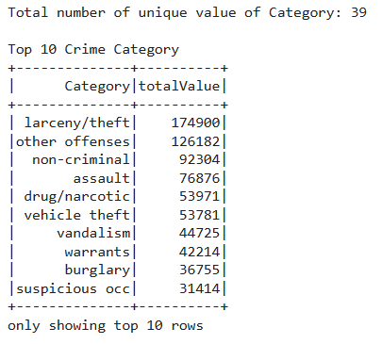
Case Solved?
Top 10 Crime categories
The most frequent category is "Larceny/Theft" with 174,900 occurrences, indicating it's the most common type of crime in the dataset.
Following "Larceny/Theft," other significant categories include "Other Offenses" (126,182 occurrences) and "Non-Criminal" (92,304 occurrences), which suggests a diverse range of criminal activities beyond theft-related offenses.

Slide 10
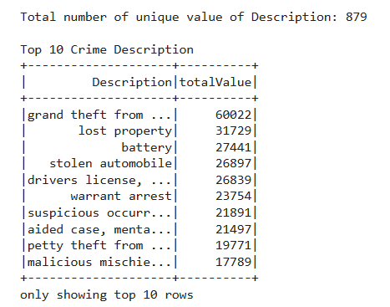
Case Solved?
Top 10 Crime descriptions
"Grand Theft from Vehicle" emerges as the most common crime description, indicating instances of significant theft from automobiles.
Other prevalent descriptions include "Lost Property," "Battery" (indicating incidents involving physical assault), "Stolen Automobile," and "Warrant Arrest."

Slide 11
Case Solved?
Models and Accuracies
Model | Count Vectorizer | TF-IDF
Logistic Regression | 97.2% | 97.19%
Naïve Bayes | 99.35% | 99.50%
Decision tree Classifier | 47.18%
Random Forest Classifier | 73.56%
KNN | 75.56%
Overall, Naive Bayes models consistently performed exceptionally well, indicating that they might be suitable for this specific classification task. Logistic Regression also showed robust performance, making it a reliable choice. Random Forest, while not as accurate as Naive Bayes, still provided decent performance, especially when considering feature engineering. Decision trees, however, showed the lowest accuracy, suggesting they might need further tuning or feature adjustments.

Slide 12
Any Questions?

